Slide 1
Design and Testing of a Low-Cost Intelligent Emergency Stop System for Autonomous Ground Vehicles
Kyle Thompson and David Bevly, PhD

Slide 2
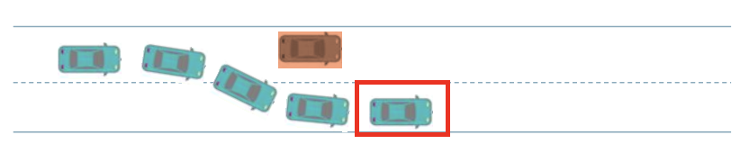
Introduction & Motivation
Autonomous UGVs experience system failures during operation (more common with systems still in development) [1]
The operating environment can prevent human intervention: communication latency, contested environments, fully autonomous operation
Basic emergency stop (cut throttle and apply brake) is not always safe: obstacles, complex terrain [2]
To handle the more complex scenarios an intelligent system is needed [3]
Study of Autonomous Vehicle Disengagements [1]
Disengagement Cause | Disengagement Percentage
Internal System Faults | 52%
Environmental Causes | 11%
Human Takeover | 30%
Figure 1: Obstacle Scenario
2

Slide 3
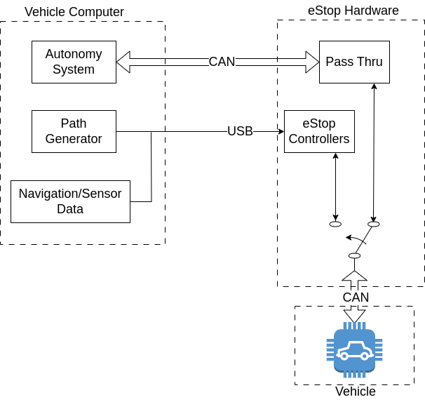
System Design
In addition to the requirement for intelligence, the estop system also needs to be redundant [5], [7]
        The estop system exists between the main autonomy computer and the vehicle’s CAN interfaces
External system continuously provides a target safe stop path and navigation information [4]
The hardware needs to be powerful enough to perform intelligent estops, while minimizing cost incurred on the full system [6]
Figure 2: Proposed Estop Hardware Configuration
3

Slide 4
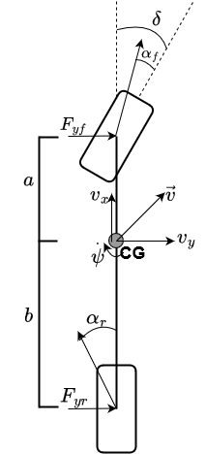
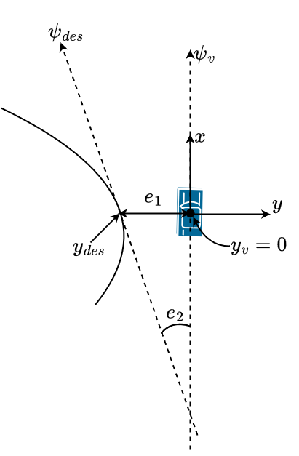
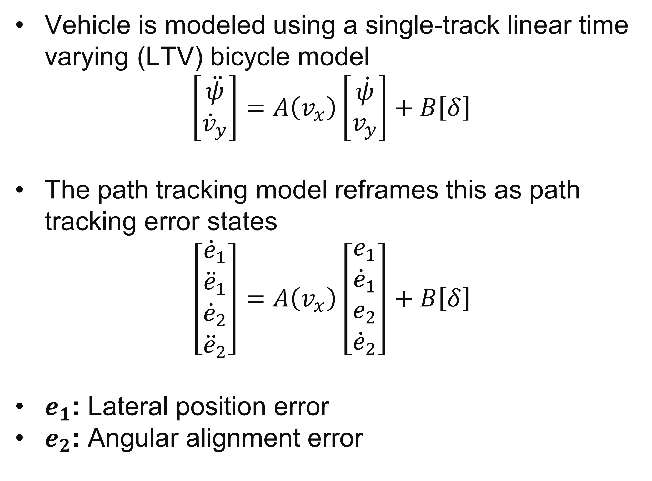
Path Tracking Model
Vehicle is modeled using a single-track linear time varying (LTV) bicycle model
$$\left[\begin{aligned}\ddot{ψ} \\ {\dot{v}}_{y}\end{aligned}\right]=A\left(v_{x}\right)\left[\begin{aligned}\dot{ψ} \\ v_{y}\end{aligned}\right]+B\left[δ\right]$$
The path tracking model reframes this as path tracking error states
$$\left[\begin{aligned}{\dot{e}}_{1} \\ {\ddot{e}}_{1} \\ {\dot{e}}_{2} \\ {\ddot{e}}_{2}\end{aligned}\right]=A\left(v_{x}\right)\left[\begin{aligned}e_{1} \\ {\dot{e}}_{1} \\ e_{2} \\ {\dot{e}}_{2}\end{aligned}\right]+B\left[δ\right]$$
$e_{1}$: Lateral position error
$e_{2}$: Angular alignment error
Figure 3: Vehicle Models. Left: Linear Bicycle Model. Right: Path Tracking Model.
4

Slide 5
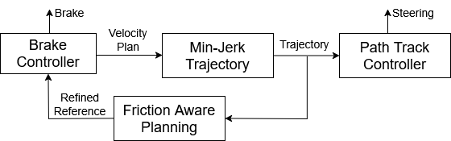
Algorithms
Brake Controller: Bring the vehicle to a stop while minimizing peak brake force
Minimum Jerk Trajectory Generator: Generate a min-jerk trajectory that provides continuous reference states for path tracking controller
Path Tracking Controller: Track reference path while minimizing steering requirements
Friction Aware Planning: Refine braking plan based on knowledge of combined force requirements
Figure 4: System Algorithms Flowchart
5

Slide 6
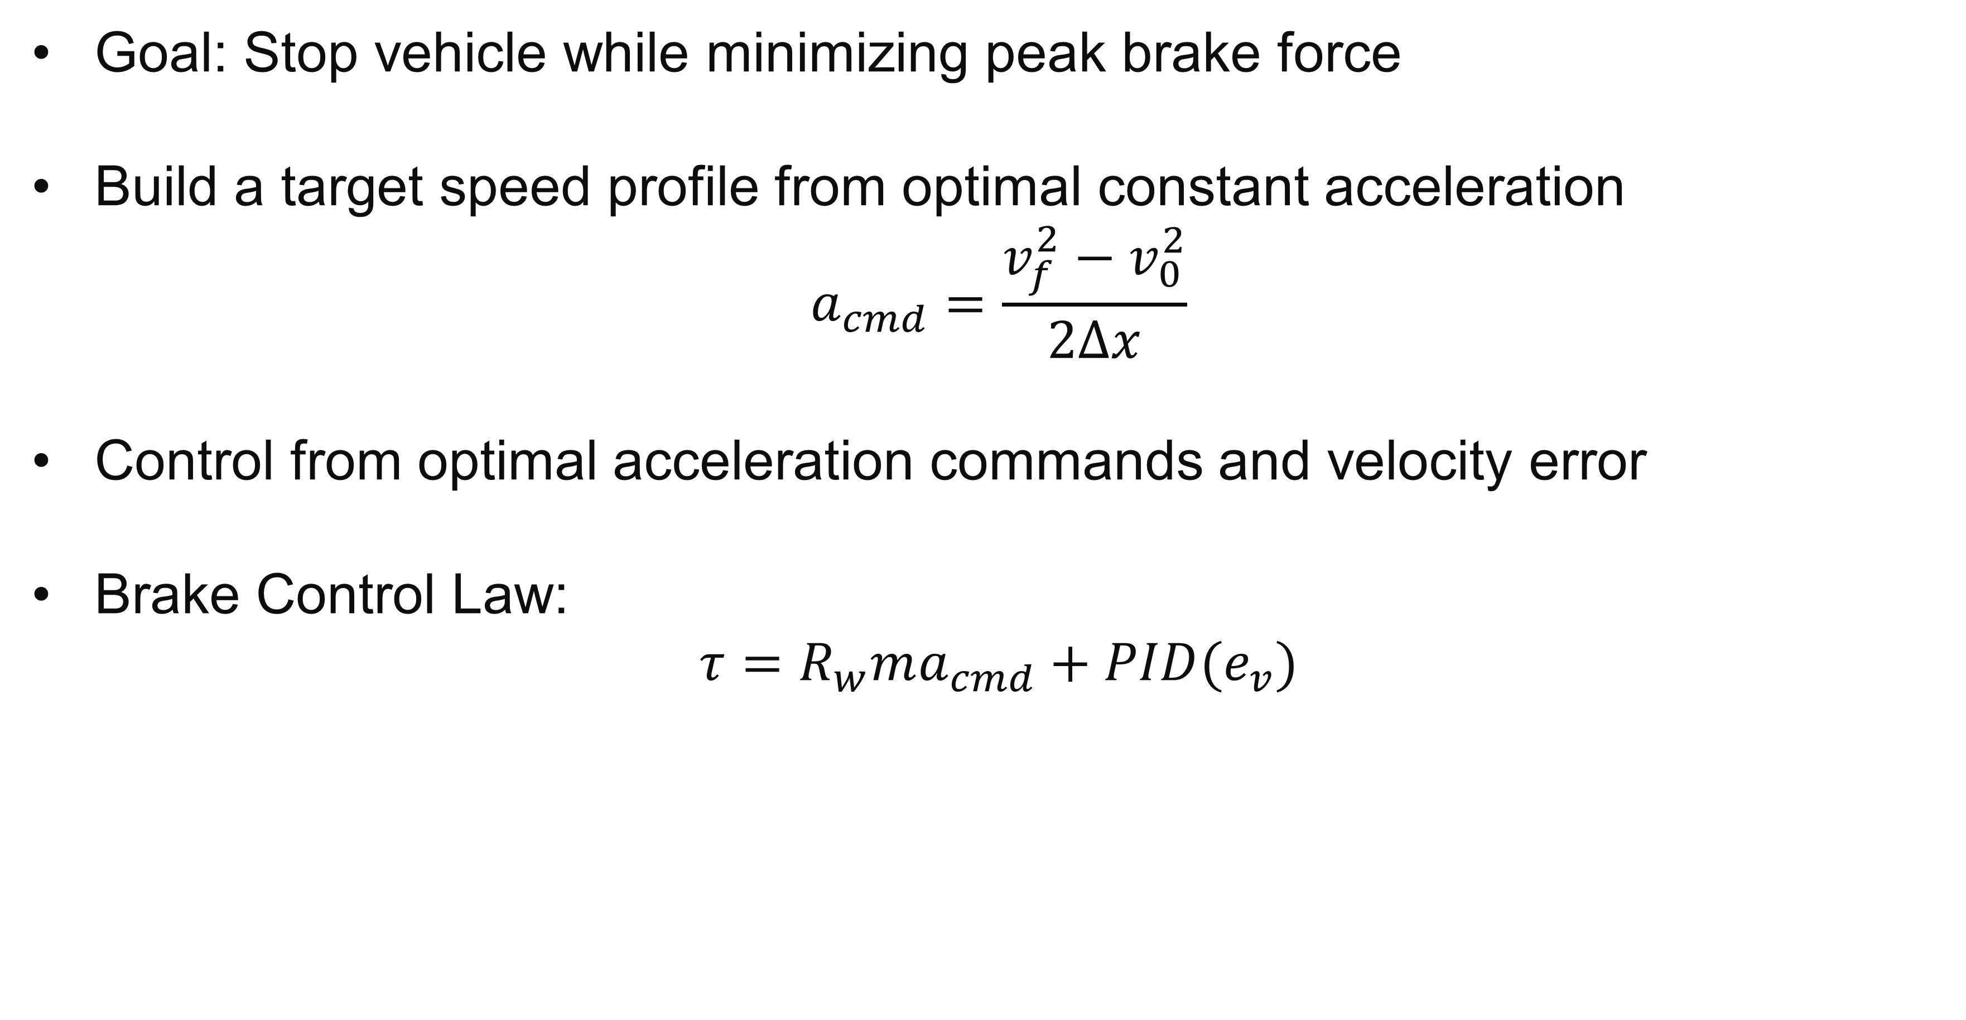
1. Brake Controller
Goal: Stop vehicle while minimizing peak brake force
Build a target speed profile from optimal constant acceleration
$$a_{cmd}=\frac{v_{f}^{2}−v_{0}^{2}}{2Δx}$$
Control from optimal acceleration commands and velocity error
Brake Control Law:
$$τ=R_{w}ma_{cmd}+PID(e_{v})$$
6

Slide 7
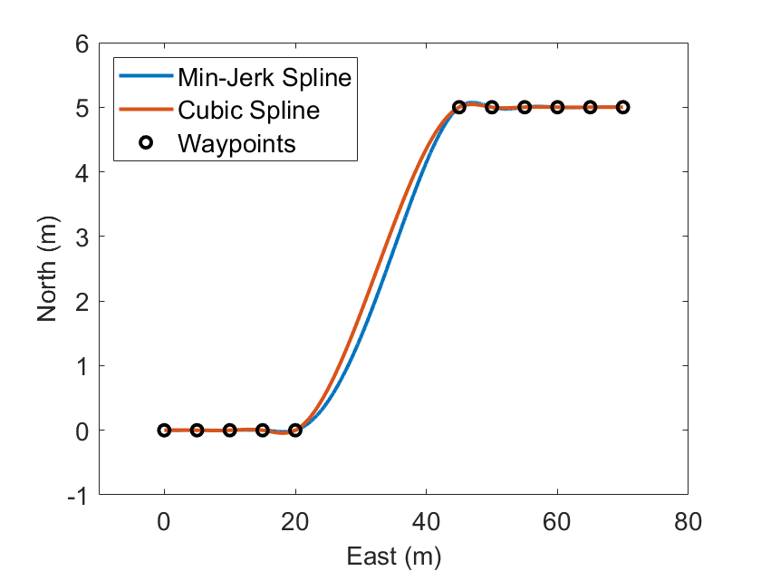
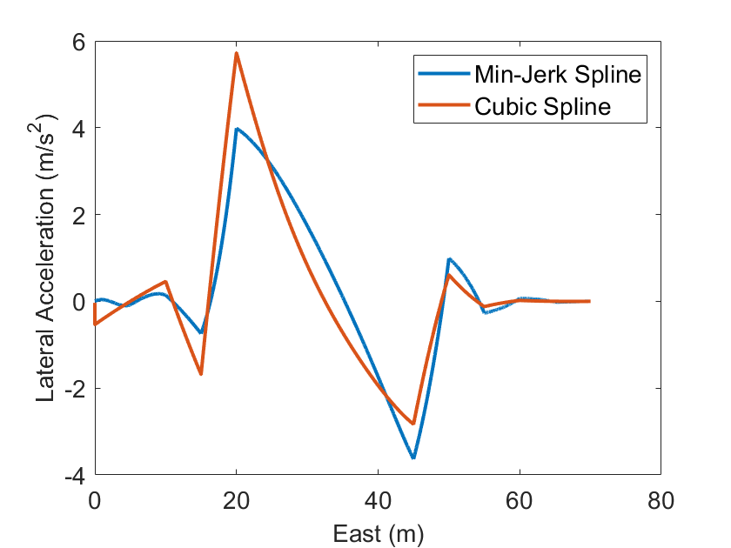
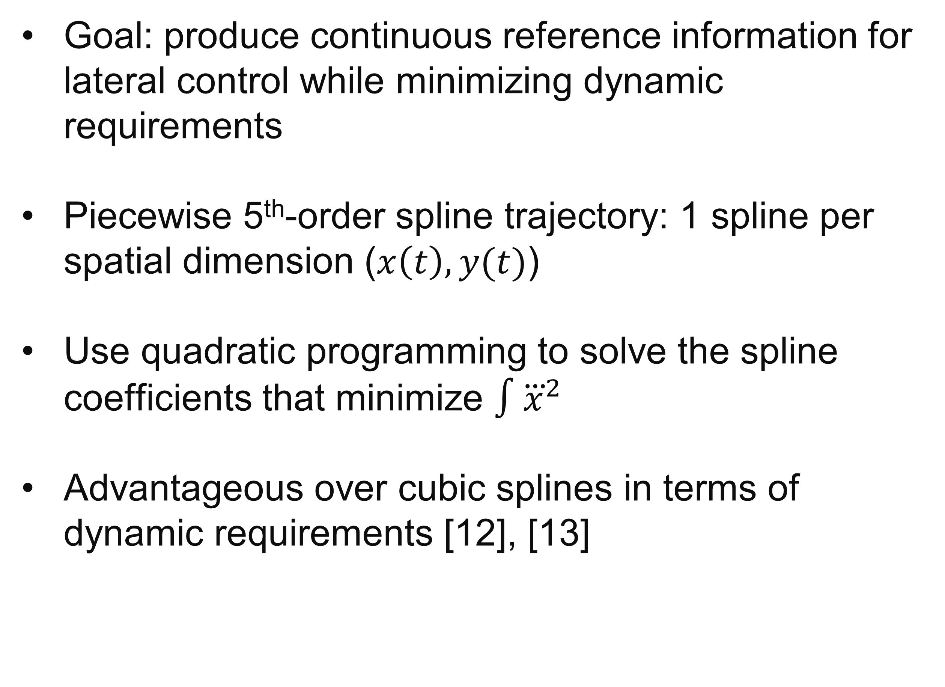
2. Minimum Jerk Trajectories
Goal: produce continuous reference information for lateral control while minimizing dynamic requirements
Piecewise 5th-order spline trajectory: 1 spline per spatial dimension ($x\left(t\right), y(t)$)
Use quadratic programming to solve the spline coefficients that minimize $∫{\overset{⃛}{x}}^{2}$
Advantageous over cubic splines in terms of dynamic requirements [12], [13]
Figure 5: Minimum jerk vs. Cubic Spline Comparison. Top: Planned Trajectories. Bottom: Lateral Acceleration Requirements.
7

Slide 8
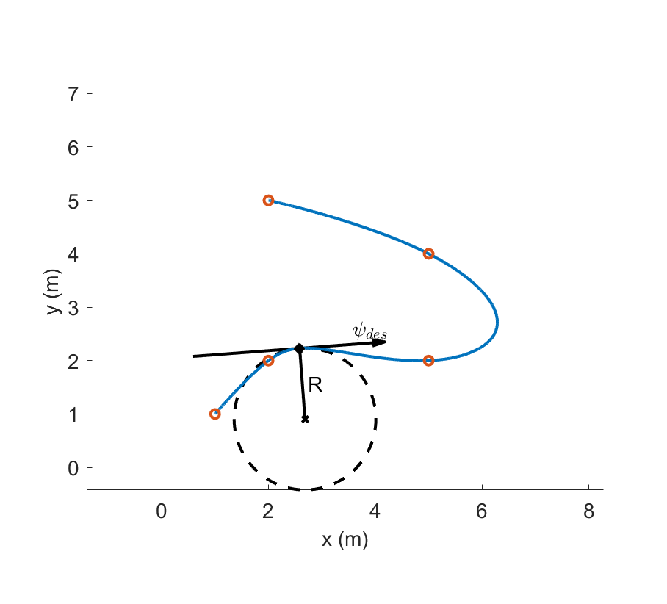
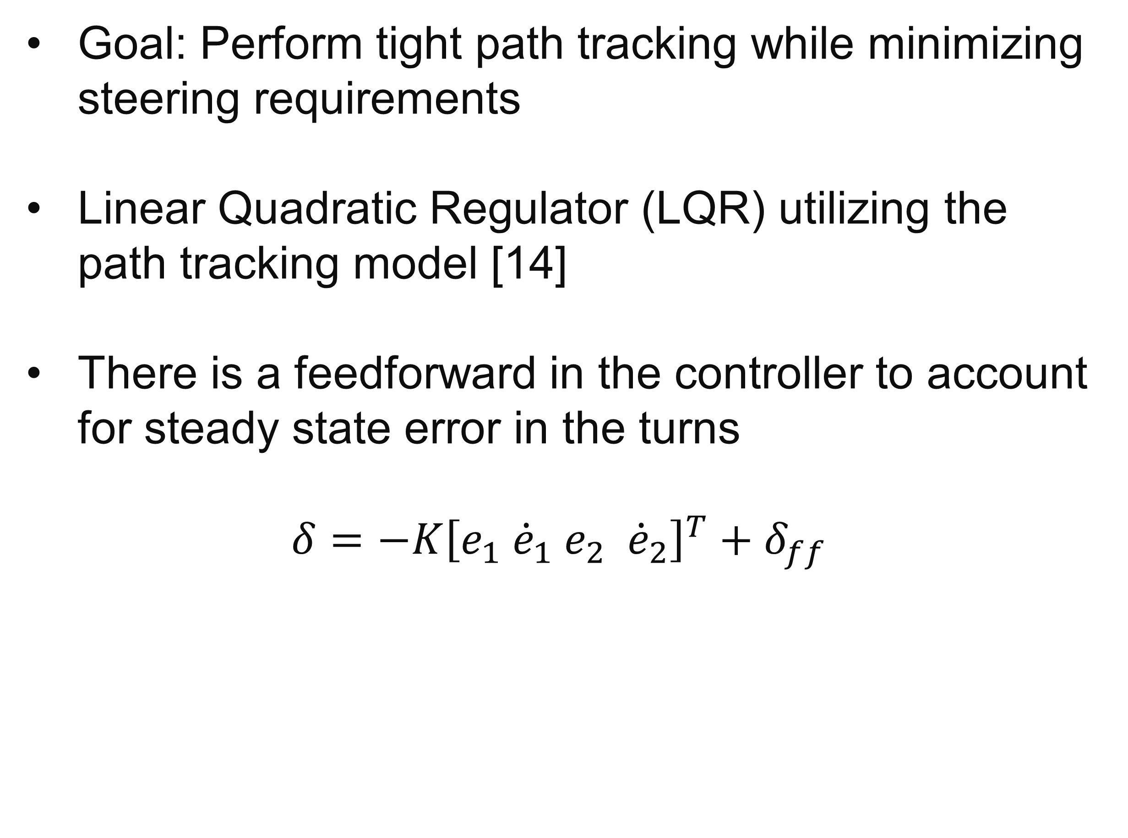
3. Path Tracking Controller
Goal: Perform tight path tracking while minimizing steering requirements
Linear Quadratic Regulator (LQR) utilizing the path tracking model [14]
There is a feedforward in the controller to account for steady state error in the turns
$$δ=−K{\left[e_{1} {\dot{e}}_{1} e_{2} {\dot{e}}_{2}\right]}^{T}+δ_{ff}$$
Figure 6: Path Reference Computation from Trajectory Spline
8

Slide 9
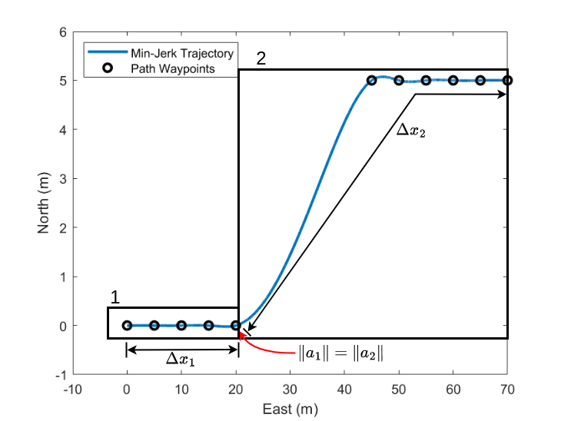
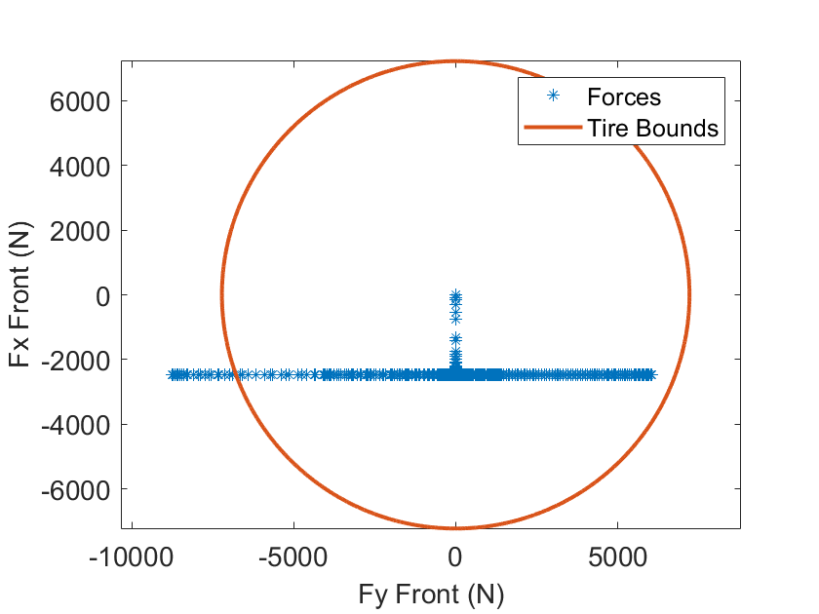
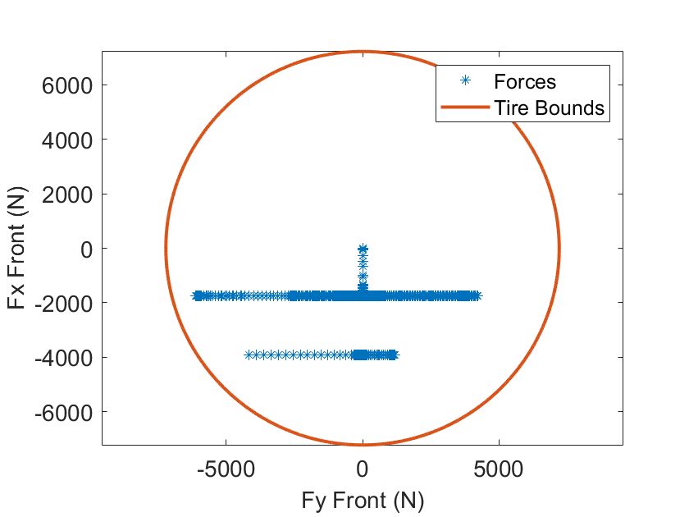

4. Friction-Aware Planning
Goal: apply heavier braking before lateral maneuver
Balance accelerations at the first turn to lower peak combined tire force[8][10][15]:
$\sqrt{a_{x1}^{2}+a_{y1}^{2}}=\sqrt{a_{x2}^{2}+a_{y2}^{2}}$
Figure 7: Acceleration Regions for Friction-Aware Velocity Planning
Figure 8: Front Tire Forces without Friction-Aware Velocity Planning (20 m/s)
Figure 9: Front Tire Forces with Friction-Aware Velocity Planning (20 m/s)
9

Slide 10
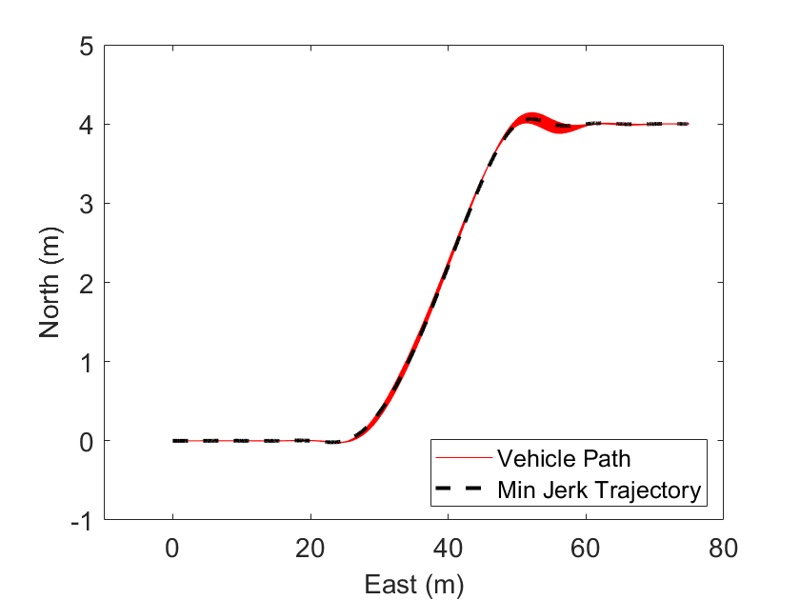
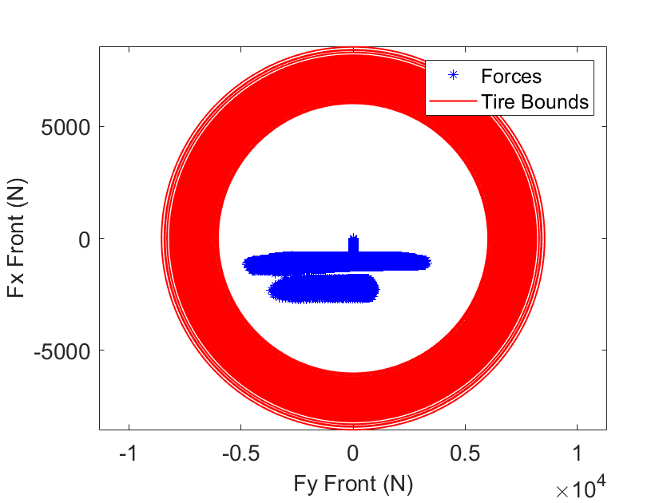
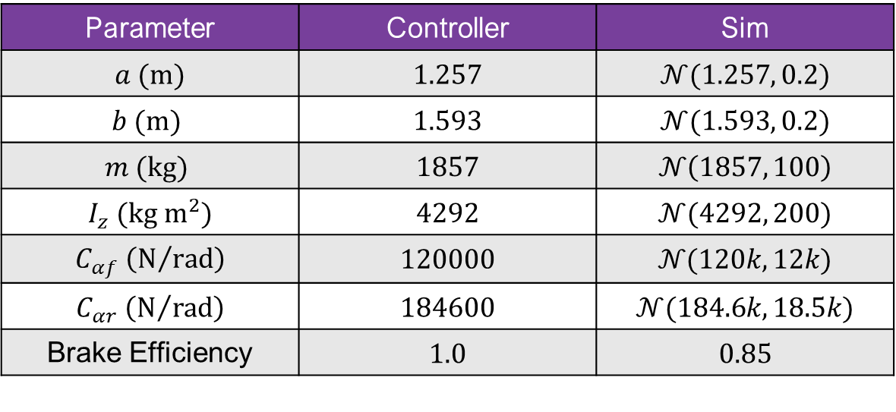
Simulation Sensitivity Analysis
1000-run Monte Carlo setup (15 m/s):
Controller uses expected values for vehicle [16]
Simulation model randomizes all vehicle model parameters
Results:
Tires never saturate and linear vehicle model remains stable under a wide variety of possible linear vehicle configurations
Vehicle Model Parameters
Parameter | Controller | Sim
$a (m)$ | $$1.257$$ | $$𝒩(1.257, 0.2)$$
$$b (m)$$ | $$1.593$$ | $$𝒩(1.593, 0.2)$$
$$m (kg)$$ | $$1857$$ | $$𝒩\left(1857, 100\right)$$
$$I_{z} (kg m^{2})$$ | $$4292$$ | $$𝒩(4292, 200)$$
$$C_{αf} \left(N/{rad}\right)$$ | $$120000$$ | $$𝒩(120k, 12k)$$
$$C_{αr} \left(N/{rad}\right)$$ | $$184600$$ | $$𝒩(184.6k, 18.5k)$$
Brake Efficiency | $$1.0$$ | $$0.85$$
10
Figure 10: Monte Carlo Path Tracking Results (1000 runs)
Figure 11: Monte Carlo Front Tire Forces (1000 runs)

Slide 11
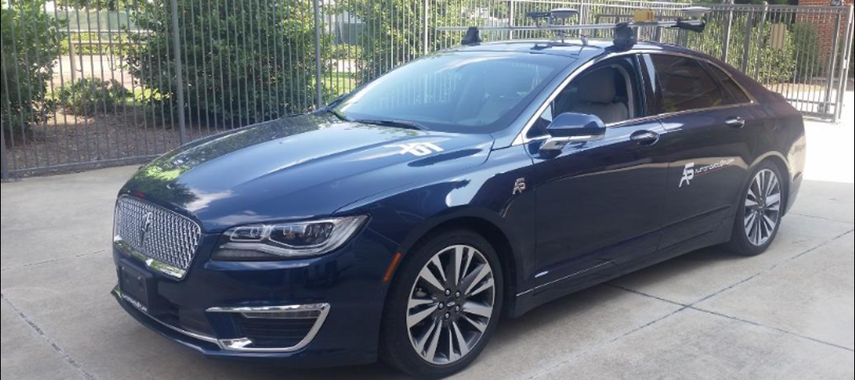
Live Testing
Live tests were conducted on a DataSpeed Lincoln MKZ
Computation hardware used was a Raspberry Pi Zero2.
Experiment:
Single lane change with a 4-meter offset between lane centers
Estops triggered at 30 mph
Processor Spec Comparison
Board | Price | RAM | Processor
Teensy 4.1 [17] | $39.60 | 1024 KB | 600 MHz
RPi Pico 2 [18] | $5.00 | 520 KB | 150 MHz
RPi Zero 2 [19] | $15.00 | 512 MB | 1 GHz
RPi 4 1GB [20] | $35.00 | 1 GB | 1.8 GHz
Figure 12: DataSpeed Lincoln MKZ
11

Slide 12
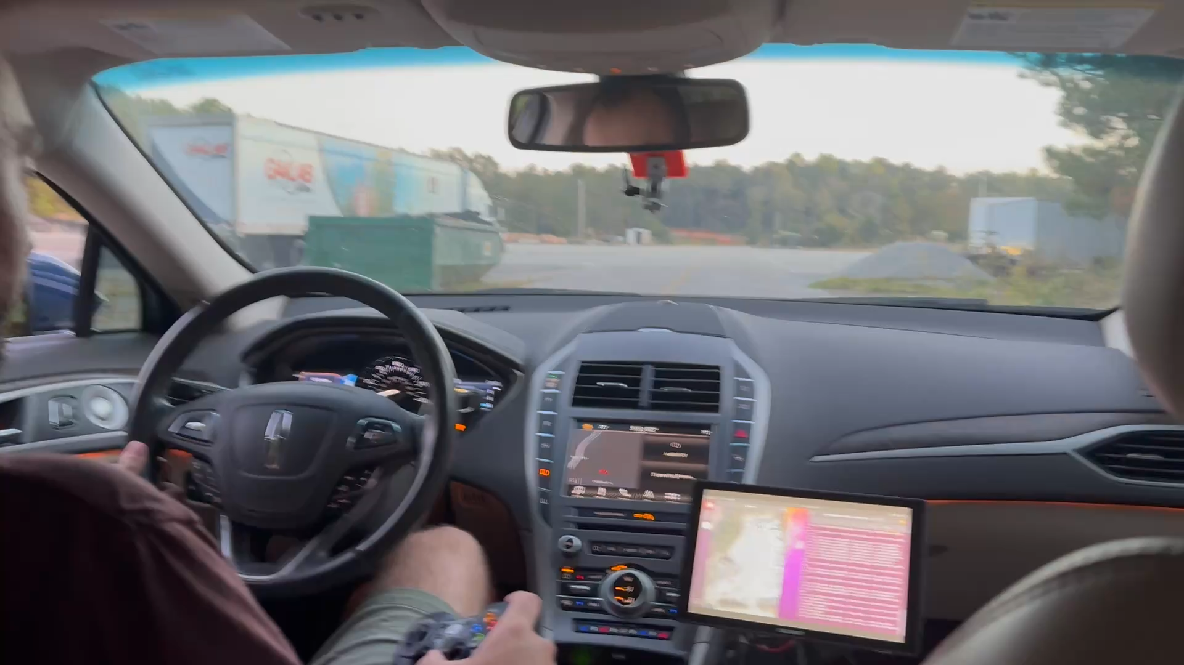
Live Test Demonstration
12

Slide 13
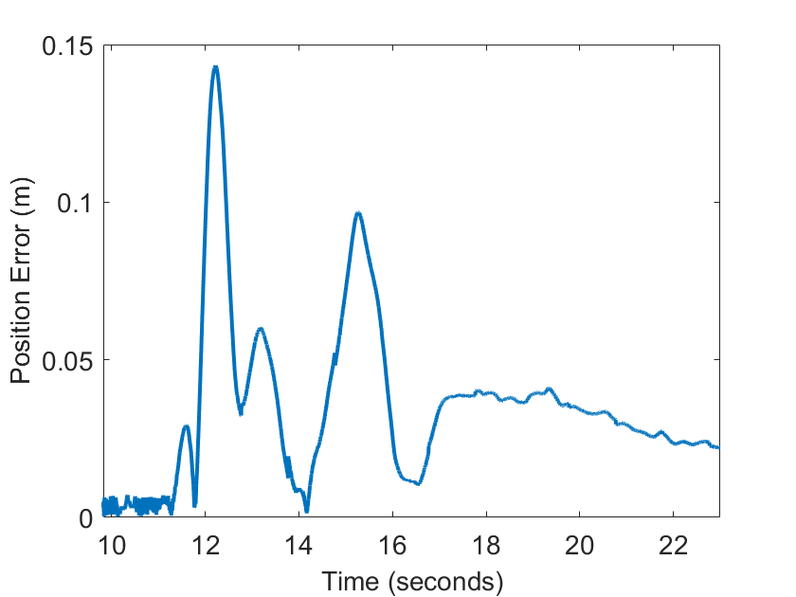
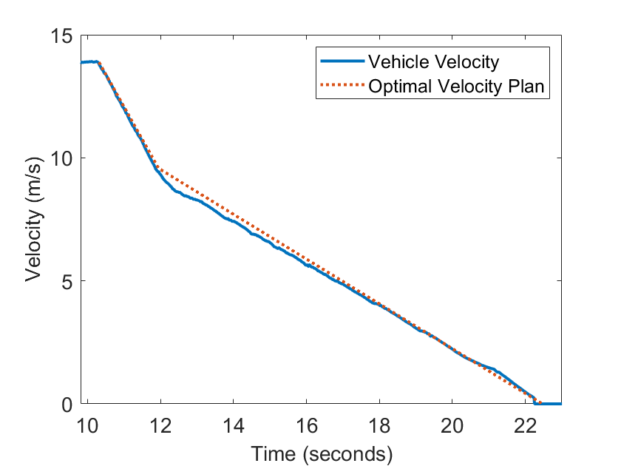
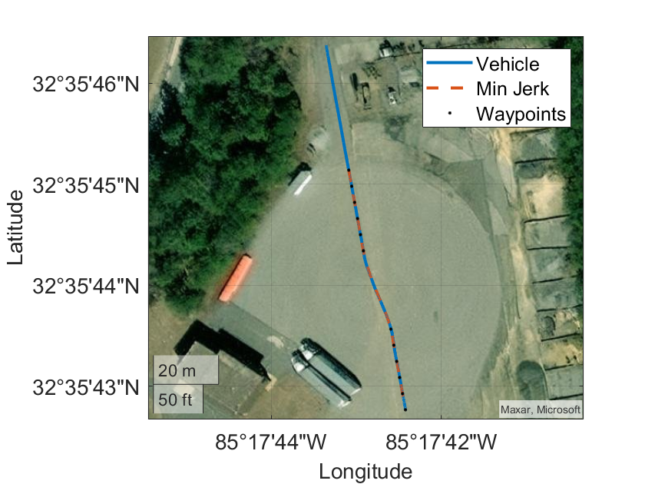
Live Test Results
Estop system safely stopped the vehicle
Lateral position tracking error never exceeded 15 cm
Longitudinal control demonstrates initial steep deceleration followed by the lighter deceleration and tracks well
Figure 13: Experimental Position Tracking Error (30 mph)
Figure 14: Experimental Velocity Response (30 mph)
13
Figure 15: Experimental Estop Maneuver (30 mph)

Slide 14
Conclusions & Future Work
The optimal estop framework has been shown to safely stop an autonomous vehicle while running on $15 computation hardware [8]
The algorithms have been shown to work in simulation on a wide variety of vehicle configurations, showing that highly accurate model parameters are not needed
Future developments include combining lateral and longitudinal planning and control into a single optimizer
Adapting LQR weights via velocity-based gain scheduling
14

Slide 15
References
[1] F. Favaró, S. Eurich, and N. Nader, “Autonomous vehicles’ disengagements: Trends, triggers, and regulatory limitations,” Accident Analysis & Prevention, vol. 110, pp. 136–148, 2018.
[2] H. Li, T. Zheng, F. Xia, L. Gao, Q. Ye, and Z. Guo, “Emergency collision avoidance strategy for autonomous vehicles based on steering and differential braking,” Scientific Reports, vol. 12, p. 22647, 2022.
[3] S. Kwon, C. Jung, T. Choi, Y. Oh, and B. You, “Autonomous emergency stop system,” in 2014 IEEE Intelligent Vehicles Symposium Proceedings, pp. 444–449, IEEE, 2014.
[4] H. Pan, M. Luo, J. Wang, T. Huang, and W. Sun, “A Safe Motion Planning and Reliable Control Framework for Autonomous Vehicles,” IEEE Transactions on Intelligent Vehicles, vol. 9, no. 4, pp. 4780–4793, 2024.
[5] E. Lowe and L. Guvenc, “Autonomous Vehicle Emergency Obstacle Avoidance Maneuver Framework at Highway Speeds,” Electronics, vol. 12, p. 4765, 2023.
[6] R. Krauss, “Combining Raspberry Pi and Arduino to form a low-cost, real-time autonomous vehicle platform,” in 2016 American Control Conference (ACC), pp. 6628–6633, IEEE, 2016.
[7] J. R. Ziehn et al., “General Fail-Safe Emergency Stopping for Highly-Automated Vehicles,” in Tagung Automatisiertes Fahren 2019, 2019.
[8] K. Thompson, “Intelligent Emergency Stop System for Autonomous Ground Vehicles Using Minimum Jerk Trajectories and Path Tracking Linear Quadratic Regulator,” Master’s thesis, Auburn University, 2025.
[9] R. Rajamani, Vehicle Dynamics and Control. Boston, MA: Springer US, 2012.
[10] T. D. Gillespie, Fundamentals of Vehicle Dynamics. Society of Automotive Engineers, 1992.
[11] R. N. Jazar, Vehicle Dynamics: Theory and Applications. New York, NY: Springer, 2009.
[12] N. V. M. Veerapaneni, “Real-time Minimum Jerk Optimal Trajectory Synthesis and Tracking for Ground Vehicle Applications,” Master’s thesis, University of Texas at Arlington, 2017.
[13] D. Mellinger and V. Kumar, “Minimum snap trajectory generation and control for quadrotors,” in 2011 IEEE International Conference on Robotics and Automation, pp. 2520–2525, IEEE, 2011.
[14] R. F. Stengel, Optimal Control and Estimation. New York: Dover Publications Inc., 1994.
[15] A. Bhoraskar and P. Sakthivel, “A review and a comparison of Dugoff and modified Dugoff formula with Magic formula,” in 2017 International Conference on Nascent Technologies in Engineering (ICNTE), pp. 1–4, IEEE, 2017.
[16] R. Brothers, “Path Following and Obstacle Avoidance for Autonomous Ground Vehicles Using Nonlinear Model Predictive Control,” Master’s thesis, Auburn University, 2020.
[17] PJRC, “Teensy 4.1 Development Board.” https://www.pjrc.com/store/teensy41.html. Accessed: 2024-11-21.
[18] Raspberry Pi, Raspberry Pi Pico 2 Datasheet. Raspberry Pi, 2024.
[19] Raspberry Pi, “Raspberry Pi Zero 2 W.” https://www.raspberrypi.com/products/raspberry-pi-zero-2-w/. Accessed: 2024-11-21.
[20] Raspberry Pi, “Raspberry Pi 4 Tech Specs.” https://www.raspberrypi.com/products/raspberry-pi-4-model-b/specifications/. Accessed: 2024-11-21.
15

